Slide 1
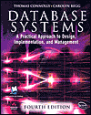
Lecture Two
Database Environment
Database Systems: A Practical Approach to Design, Implementation and Management (4th and 7th Edition)
International Computer Science S.
Carolyn Begg, Thomas Connolly

Slide 2
Lecture 2 - Objectives
Purpose of three-level database architecture.
Contents of external, conceptual, and internal levels.
Purpose of external/conceptual and conceptual/internal mappings.
Meaning of logical and physical data independence.
Distinction between DDL and DML.
A classification of data models.

Slide 3
Lecture 2 - Objectives
Purpose/importance of conceptual modeling.
Typical functions and services a DBMS should provide.
Software components of a DBMS.
Meaning of client–server architecture and advantages of this type of architecture for a DBMS.
Function and importance of the system catalog.
Notes:
A system catalog is a group of tables and views that incorporate vital details regarding a database. Every database comprised of a system catalog and the information in the system catalog specifies the framework of the database.

Slide 4
Objectives of Three-Level Architecture
All users should be able to access same data.
A user's view is immune to changes made in other views.
Users should not need to know physical database storage details.

Slide 5
Objectives of Three-Level Architecture
DBA should be able to change database storage structures without affecting the users' views.
Internal structure of database should be unaffected by changes to physical aspects of storage.
DBA should be able to change conceptual structure of database without affecting all users.

Slide 6
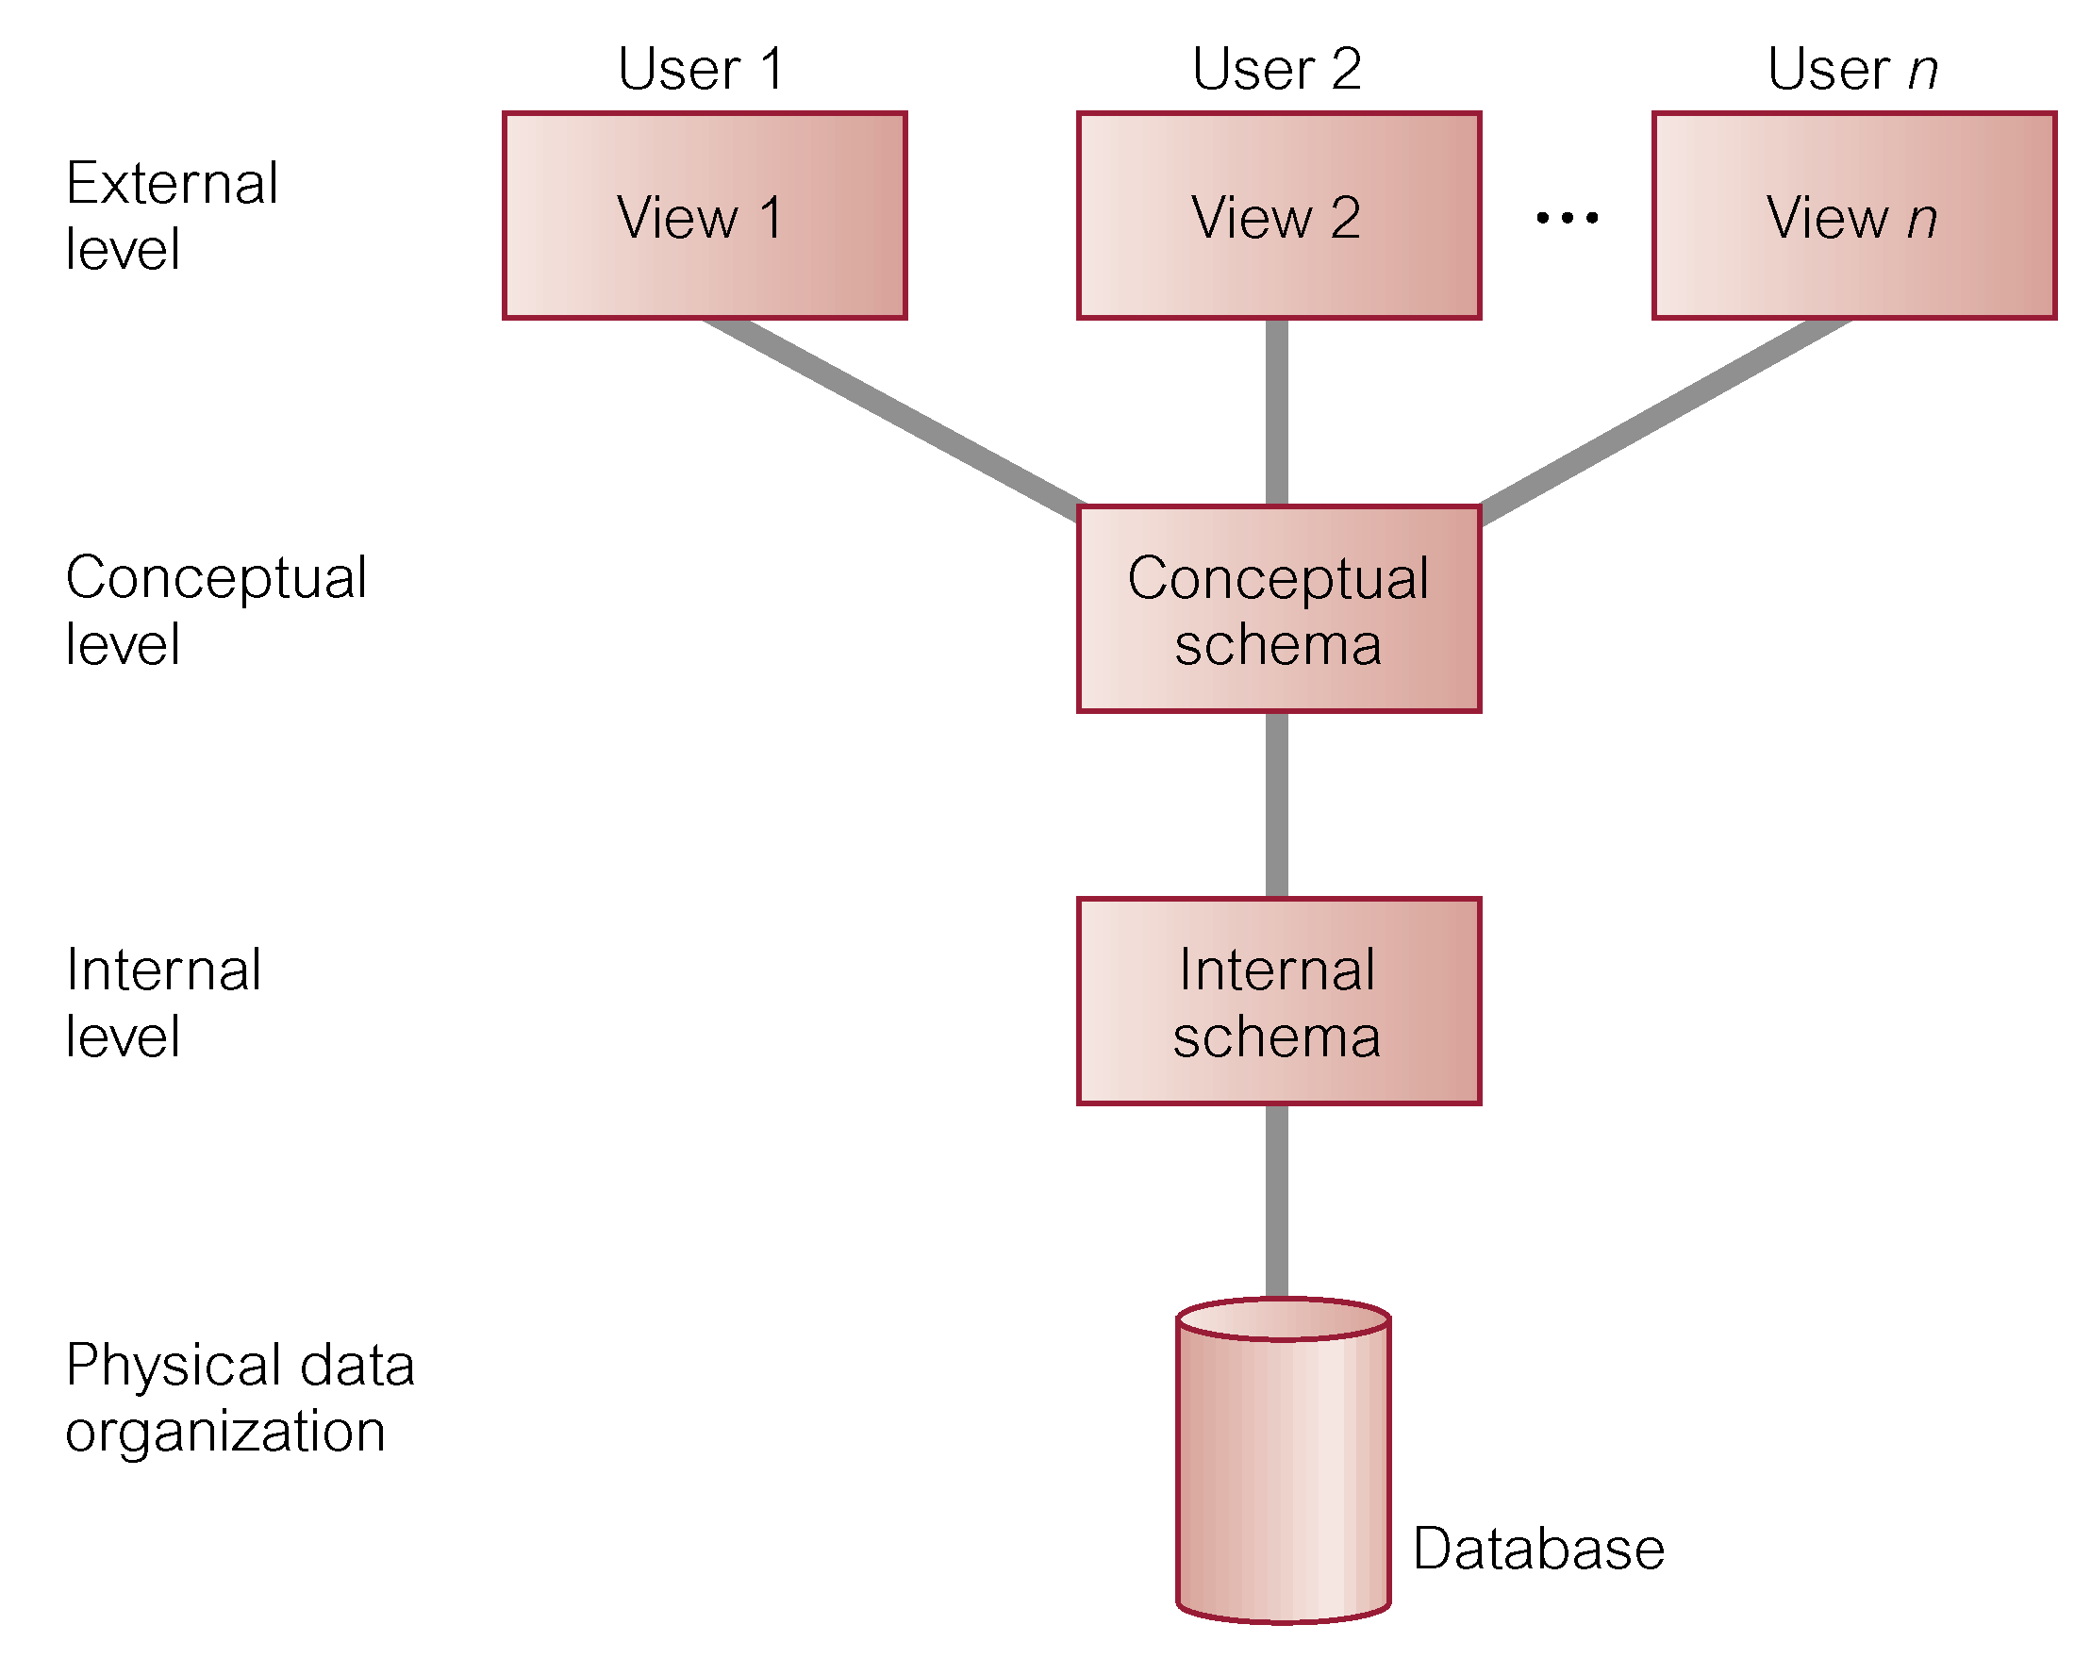
ANSI-SPARC Three-level Architecture

Slide 7
ANSI-SPARC Three-level Architecture
External Level
  Users' view of the database.
  Describes that part of database that is relevant to a particular user.
  Represents abstract view of : entities, attributes and relationships
Conceptual Level
  Community view of the database.
  Describes what data is stored in database and relationships among the data.
  Logical view of : entities, attributes and relationships{Instructions, Policies, Rules, Security, Integrity and Semantics Info, }

Slide 8
ANSI-SPARC Three-level Architecture
Internal Level
  Physical representation of the database on the computer.
  Describes how the data is stored in the database.
  Data Structures, Stored Records, Data Fields, Method of Representation of Data, Storage Structures and Indexes
  Indexing: Using a unique ID improves performance search query optimization within the database e.g. Student No, Reg No.
  Data Stored at a particular moment in time is called an Instance (state)
  Database Schema: Overall description of a database

Slide 9
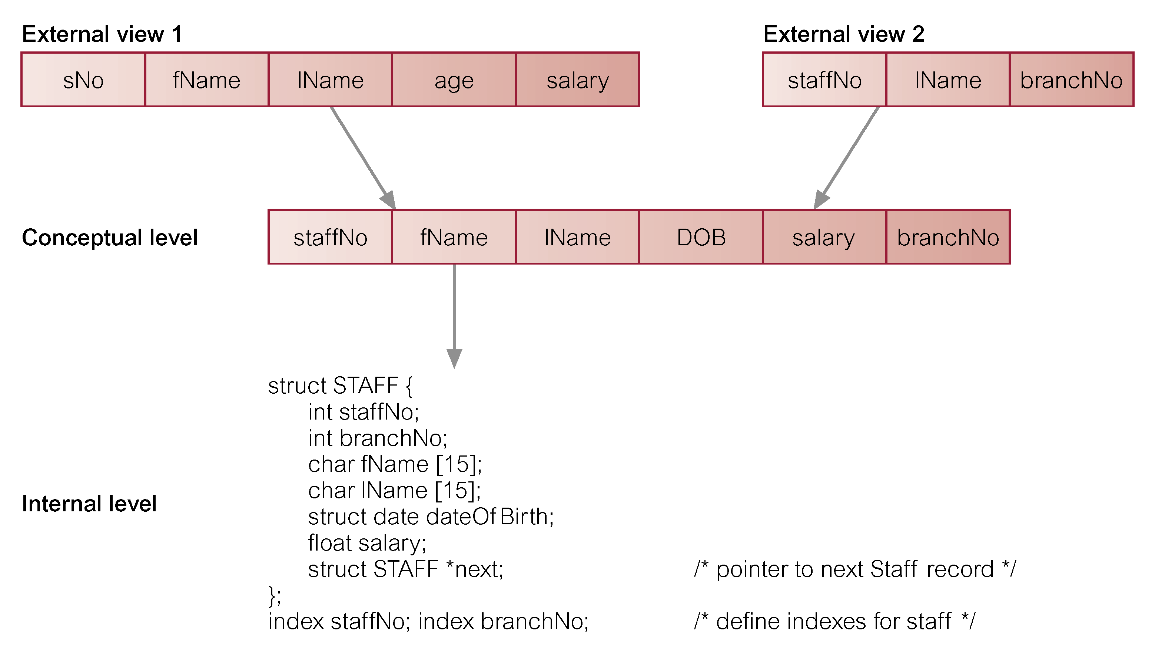
Differences between Three Levels of ANSI-SPARC Architecture
(Database Schema, Mappings and Instances)?
Notes:
Differences between the levels of a database = {*Database Schema = [External Schema, Conceptual Schema and Internal Schema]}

Slide 10
Data Independence
Overall objective of three- level architecture:
To provide Data Independence: Upper Levels are unaffected by changes in Lower Levels
Type of Data Independence:
1. Logical Data Independence
  Refers to immunity of external schemas to changes in conceptual schema.
  Conceptual schema changes (e.g. addition/removal of entities, attributes or relationships).
  Should not require changes to external schema or rewrites of application programs.

Slide 11
Data Independence
2. Physical Data Independence
  Refers to immunity of conceptual schema to changes in the internal schema.
  Internal schema changes are possible (e.g. using different file organizations, storage structures/devices, indexes, hashing algorithms).
  Should not require change to conceptual or external schemas.

Slide 12
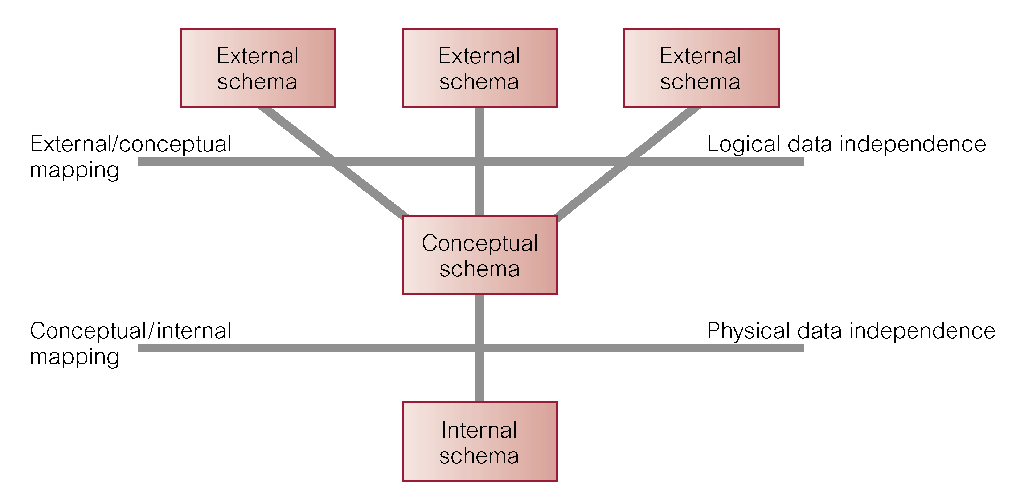
Data Independence and the ANSI-SPARC Three-level Architecture

Slide 13
Database Languages
Also called sublanguages; because no computing constructs required e.g. conditional or iterative statements.
A data sublanguage consists of two parts:
1- Data Definition Language (DDL)
  Used by the database schema.
  Allows the DBA or user to describe and name entities, attributes, and relationships required for the application
  plus any associated integrity and security constraints.

Slide 14
Database Languages
2- Data Manipulation Language (DML)
  Used to read and update the database.
  Provides basic data manipulation operations on data held in the database (query language) – (SQL).
  Data manipulation operations: add, delete, retrieve, update data in database.
Procedural DML
  allows user to tell system exactly “how” to manipulate data.
Non-Procedural DML
  allows user to state “what” data is needed rather than how it is to be retrieved.

Slide 15
Database Languages
Fourth Generation Language (4GL):Presentation languages(Query), Require fewer line while querying the database and define update, insert and retrieve from database to build application.
  Query Languages: Query Language Processing Using SQL
  Forms Generators: Data inputs and displays layout forms
  Report Generators: Create reports stored in database
  Graphics Generators: Retrieve data and display graphical insights for trends and relationships in data.
  Application Generators: Produce a program to interface with the data.

Slide 16
Data Model
Integrated collection of concepts for describing data, relationships between data, and constraints on the data in an organization.
Data Model comprises:
  A structural part: set of rules
  A manipulative part: type of operations on the data
  Possibly a set of integrity rules: ensure data is accurate

Slide 17
Data Model
Purpose
  To represent data in an understandable way.
Categories of data models include:
  Object-based: Represent entities (distinct objects), attributes (properties), relationships (associations between entities)
  Record-based: defines a fixed number of fields (field length)
  Physical: how data is stored in a computer

Slide 18
Data Models
Object-based Data Models (entities, attributes, relationships)
  Entity-Relationship
  Semantic
  Functional
  Object-Oriented
Record-based Data Models
  Relational Data Model
  Network Data Model
  Hierarchical Data Model
Physical Data Models: “How data is stored on a computer”

Slide 19
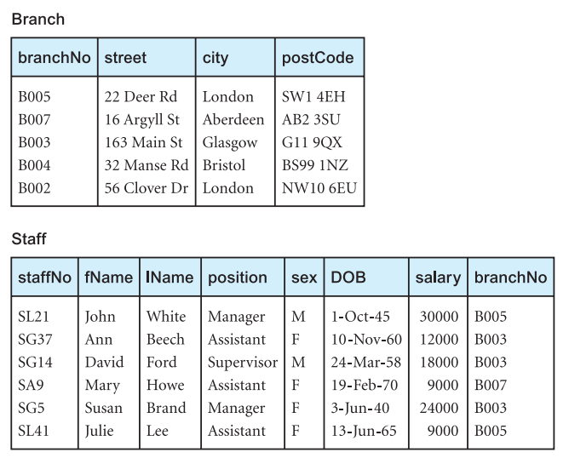
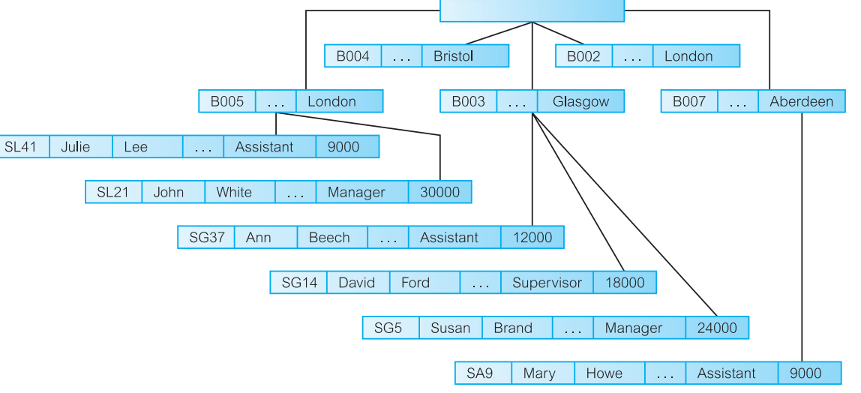
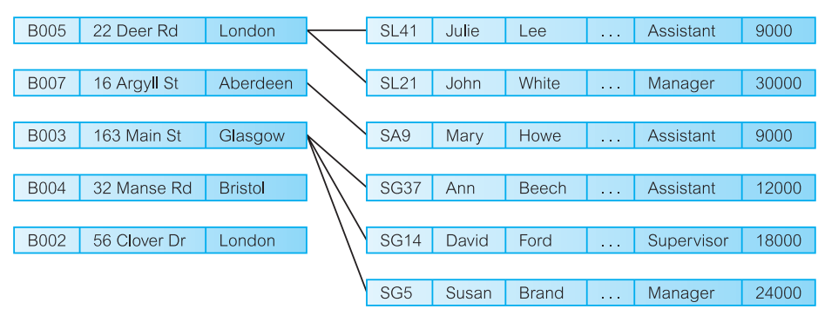
Hierarchical Data Model: “Restricted Collection of Records” Represented by Set”
Network Data Model: “Collection of Records and its relationships sets”
Relational Data Model:
“a branch office has staff”

Slide 20
Conceptual modeling
Conceptual schema is the core of a system supporting all user views.
Should be complete and accurate representation of an organization's data requirements.
Conceptual modeling is process of developing a model of information use that is independent of implementation details.
Result is a conceptual data model.

Slide 21
Functions of a DBMS
Data Storage, Retrieval, and Update.
A User-Accessible Catalog: Description of data items stored and accessible to users.
Transaction Support: Ensure updates correspond to a given transaction
Concurrency Control Services: Ensure data is updated concurrently for multiple users.
Recovery Services in event of failure.

Slide 22
Functions of a DBMS
Authorization Services for authorised users.
Support for Data Communication Services.
Integrity Services.
Services to Promote Data Independence from actual structure to services.
Utility Services e.g. import, monitor, statical analysis facilities.

Slide 23
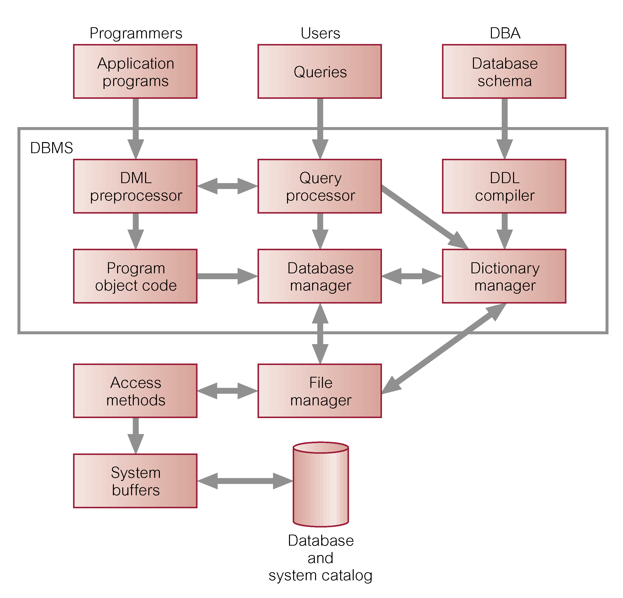
Components of a DBMS “People”

Slide 24
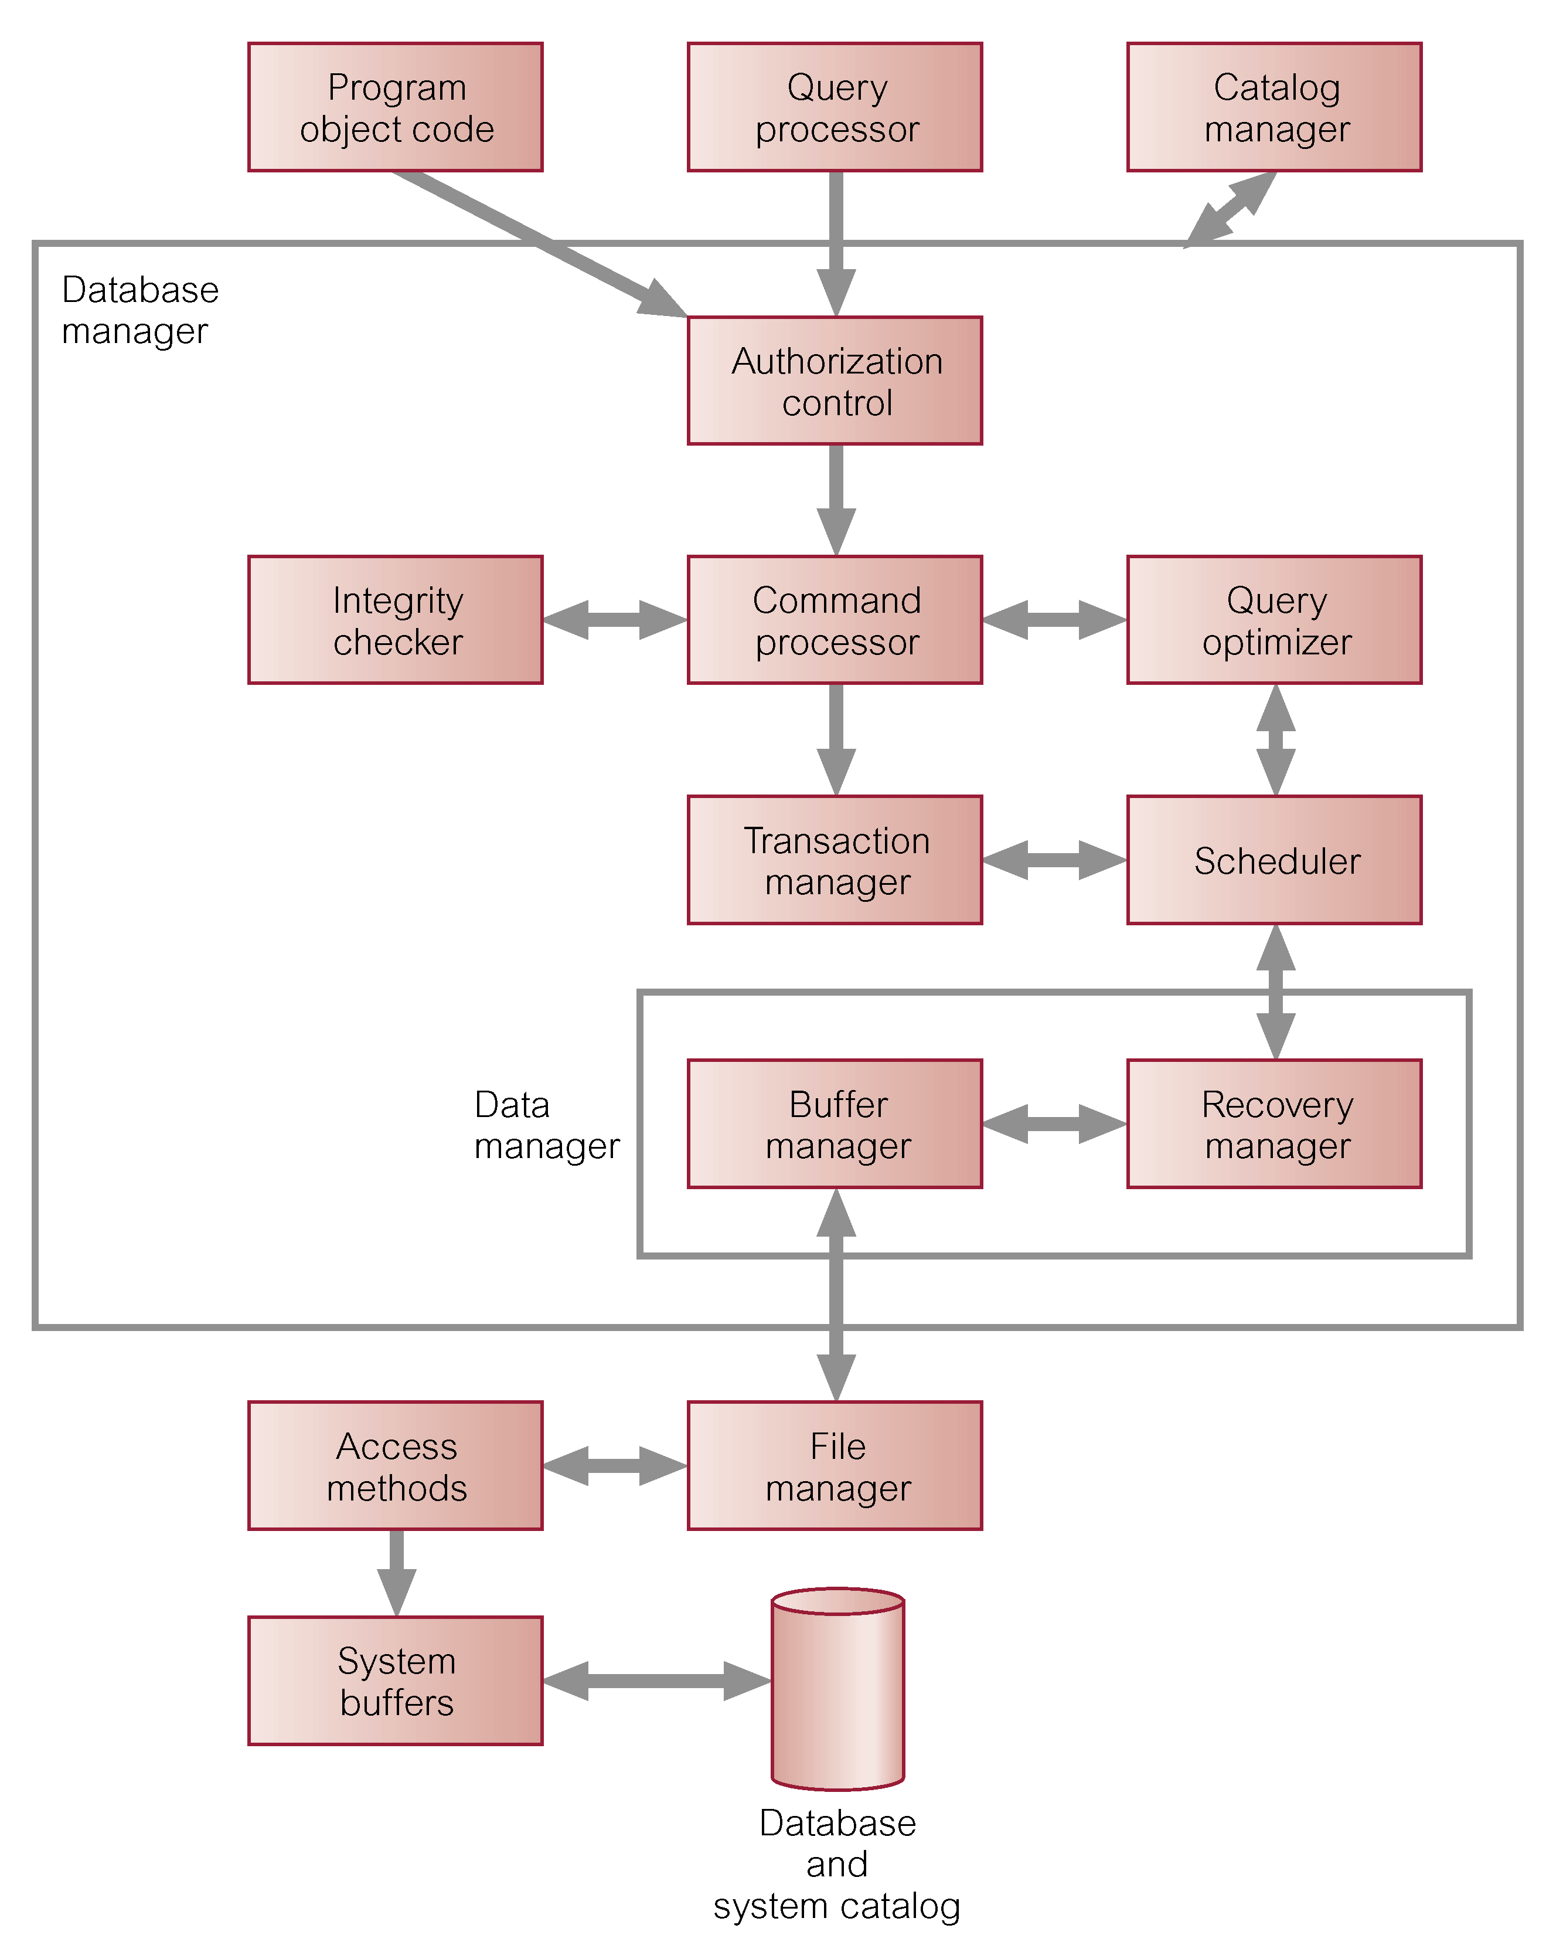
Components of Database Manager (DM)

Slide 25
Multi-User DBMS Architectures
Teleprocessing: One computer as the Single central processing unit (CPU) and a number of terminals (dumb) cabled to the central computer.
File-server: Processing is distributed abut the network (LAN) setting. Holds files required by the applications and DBMS.
Client-server

Slide 26
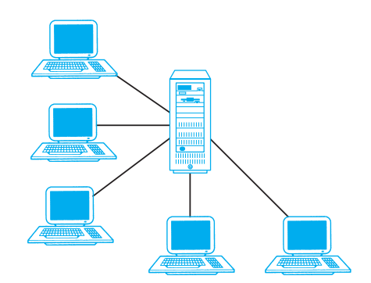
Teleprocessing Topology

Slide 27
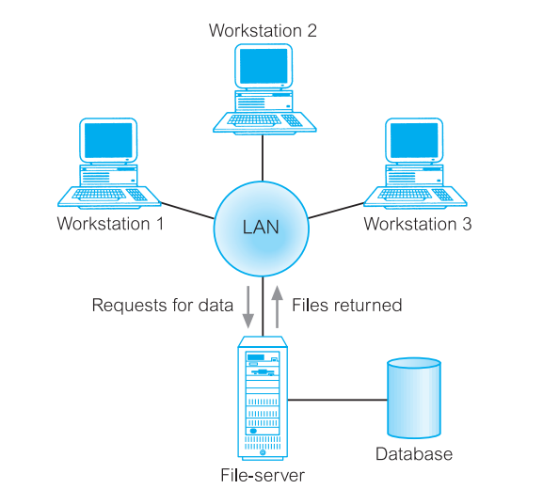

File Server Architecture
Example of SQL

Slide 28
Client-server
Server holds the database and the DBMS.
Client manages user interface and runs applications.
Advantages include:
  wider access to existing databases
  increased performance
  possible reduction in hardware costs
  reduction in communication costs
  increased consistency.

Slide 29
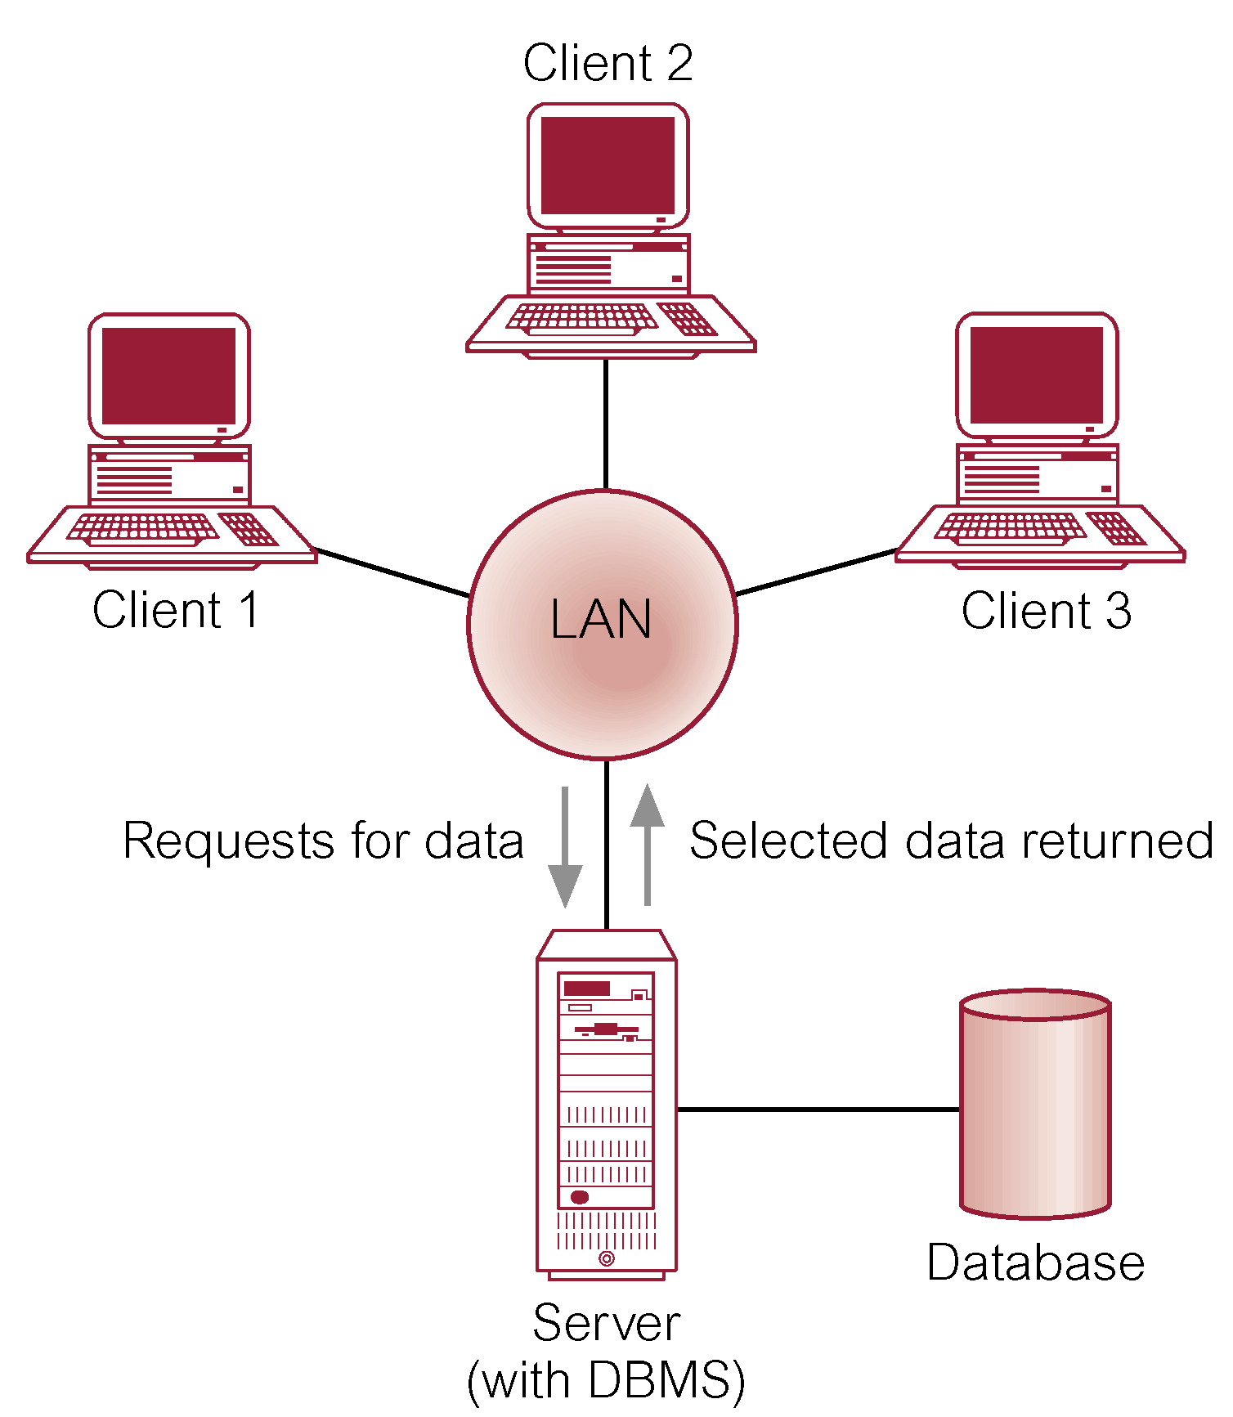
Client-server Architecture

Slide 30
System Catalog
Repository of information (metadata) describing the data in the database.
Typically stores:
  Names of authorized users.
  Names of data items in the database.
  Constraints on each data item.
  Data items accessible by a user and the type of access.
Used by modules such as Authorization Control and Integrity Checker.

Slide 31
Extra Reading Materials About Database Architectures?:
N-Tier Architectures*
Distributed DBMS*
Web and Service and Oriented Architectures*
Cloud Computing*
Data warehouse*
Transaction Processing Monitors*
Ref: Database Systems: (7th Edition)

